Slide 1
” MONITORING OF JOURNALISTIC SELF-REGULATORY BODIES IN MONTENEGRO” (THIRD REPORT FOR THE PERIOD OCTOBER 2013 – MARCH 2014)
12 May 2014
Authors:
Dragoljub Duško Vuković, in relation to print media and web portals
Marijana Buljan, in relation to TV news programmes
editor:
tea gorjanc prelević

Slide 4
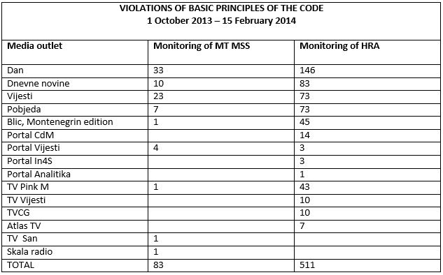

Slide 5
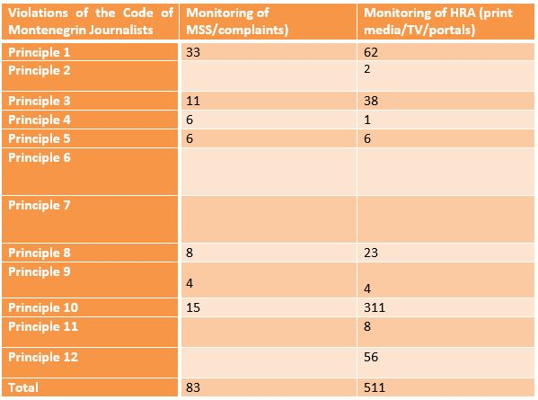

Slide 7
Violations of the principle of innocence
Blic | Dan | Dnevne novine | Pobjeda | Vijesti
25 | 125 | 57 | 51 | 44

Slide 8
Violations of Principle 1
Violations of Principle 3
 | Dan | Vijesti | Pobjeda | TV Pink | TVCG
MSS | 13 | 13 | 4
HRA | 14 | 11 | 9 | 13 | 5
 | Dan | Vijesti | Pobjeda | TV Pink | TVCG
MSS | 4 | 1 | 1
HRA | 1 | 3 | 6 | 21

Slide 10
TV – Violations of the Code
 | Načelo 1 | Načelo 3 | Načelo 8 | Načelo 10 | Načelo 11
Pink M | 13 | 21 |  | 8 | 1
TV Vijesti | 2 |  | 5 | 2 | 1
TVCG | 5 |  | 3 |  | 2
Atlas TV | 1 |  | 5 |  | 1
Prva
 | 21 | 22 | 13 | 10 | 5

